Slide 1
Digital Technologies and Computational Thinking Jumpstarter workshops
MATT BOWER
matt.bower@mq.edu.au
ANJA AUGSDOERFER
anja.augsdoerfer@mq.edu.au

Slide 2


Welcome!
PD designed to develop your digital technologies and computational thinking pedagogical expertise
Hands on, collegial, supportive approach
Involves a 2 hour workshop, 4 hours of independent inquiry, design and development, 1 hour of reflection and feedback
Completing all aspects of the program earns 7 hours of NESA accreditation
PD proudly sponsored by Google

Slide 3


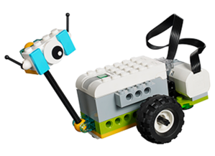
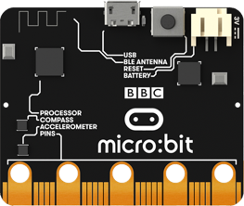
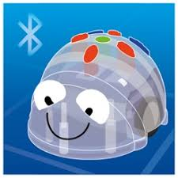
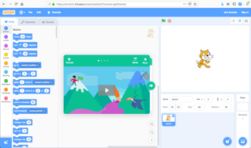

In this 2-hour workshop…
Afternoon tea, introduction (10 mins)
Discussing foundational concepts (computational thinking, problem decomposition algorithmic thinking, pattern recognition, abstraction) (10 mins)
Hands-on workstation activities, reflections and sharing (45 mins)
Brainstorming and sharing lesson/module ideas for your class (10 mins)
Discussing pedagogy, equity, diversity & accessibility (10 mins)
Where to find out more, e.g. DigiTech Hub, CSER MOOC (5 mins)
Next steps (refine & implement lesson, report-back via Moodle) (5 mins)
Brief workshop evaluation (5 mins)

Slide 4

AITSL/NESA Teaching Standards being targeted
2.6.2 – Use effective teaching strategies to integrate ICT into learning and teaching programs to make selected content relevant and meaningful
3.4.2 – Select and/or create and use a range of resources, including ICT, to engage students in their learning
6.2.2 – Participate in learning to update knowledge and practice, targeted to professional needs and school and/or system priorities
6.3.2 – Contribute to collegial discussions and apply constructive feedback from colleagues to improve professional knowledge and practice
6.4.2 – Undertake professional learning programs designed to address identified student learning needs
Notes:
https://www.aitsl.edu.au/teach/standards?gclid=Cj0KCQjwrdjnBRDXARIsAEcE5YlPYZiTiVwB6EABgv5MphBsTBtBObeWwGiUMMrGyeupgaRkh68ZEqQaAu7iEALw_wcB

Slide 5

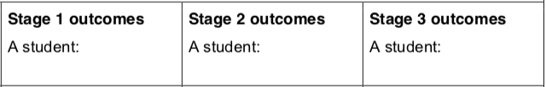
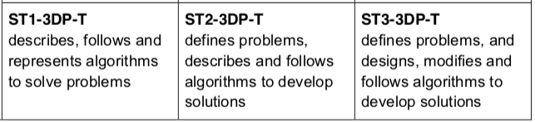
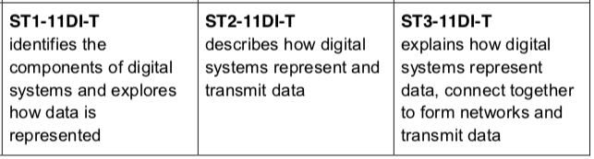
NESA K-6 Science & Technology outcomes being targeted
The integrated workstations will also demonstrate how other Science & Technologies K-6 Outcomes can be met

Slide 6
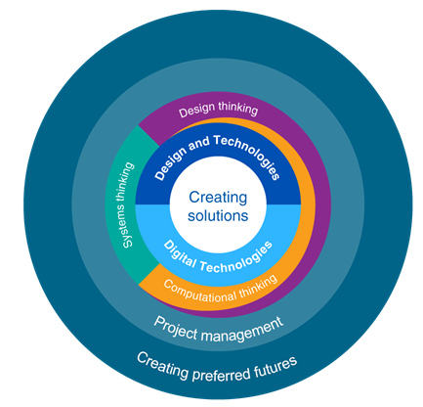
The Australian Curriculum: Technologies
The Australian Curriculum: Technologies comprises two mandatory subjects from Foundation to Year 8: Design and Technologies and Digital Technologies (optional for Year 9 & 10)
Computational thinking is a defining feature of the Australian curriculum in Digital Technologies

Slide 7


Australian Digital Technologies Curriculum Outcomes
STAGE 1 (F-2)
Knowledge & Understanding
Digital Systems: Identify and explore a range of digital systems with peripheral devices for different purposes, and transmit different types of data (ACTDIK007)
Processes & Production Skills
Investigating and defining: Define simple problems, and describe and follow a sequence of steps and decisions (algorithms) needed to solve them (ACTDIP010)
https://www.australiancurriculum.edu.au/f-10-curriculum/technologies/digital-technologies/
Notes:
For the Y3-4, Y5-6 note the Producing & Implementing
For the Y5-6, note the generating and defining

Slide 8
Australian Digital Technologies Curriculum Outcomes
STAGE 2
Knowledge & Understanding
Identify and explore a range of digital systems with peripheral devices for different purposes, and transmit different types of data (ACTDIK007)
Processes & Production Skills
Define simple problems, and describe and follow a sequence of steps and decisions (algorithms) needed to solve them (ACTDIP010)
Implement simple digital solutions as visual programs with algorithms involving branching (decisions) and user input (ACTDIP011)
https://www.australiancurriculum.edu.au/f-10-curriculum/technologies/digital-technologies/
Notes:
For the Y3-4, Y5-6 note the Producing & Implementing
For the Y5-6, note the generating and defining

Slide 9
Australian Digital Technologies Curriculum Outcomes
STAGE 3
Knowledge & Understanding
Examine the main components of common digital systems and how they may connect together to form networks to transmit data (ACTDIK014)
Processes & Production Skills
Define problems in terms of data and functional requirements drawing on previously solved problems (ACTDIP017)
Design a user interface for a digital system (ACTDIP018)
Design, modify and follow simple algorithms involving sequences of steps, branching, and iteration (repetition) (ACTDIP019)
Implement digital solutions as simple visual programs involving branching, iteration (repetition), and user input (ACTDIP020)
https://www.australiancurriculum.edu.au/f-10-curriculum/technologies/digital-technologies/
Notes:
For the Y3-4, Y5-6 note the Producing & Implementing
For the Y5-6, note the generating and defining

Slide 10

What is computational thinking?

Slide 11
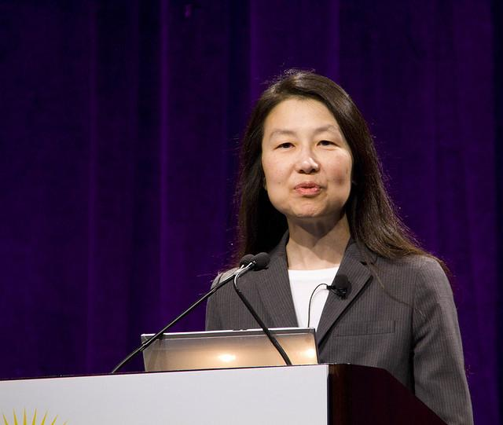
What is computational thinking?
“Computational thinking involves solving problems, designing systems, and understanding human behavior, by drawing on the concepts fundamental to computer science.”
(Wing, 2006, p. 33)
https://www.flickr.com/photos/rwoan/4052660923/
Notes:
Conceptualizing, not programming
Fundamental, not rote skill
A way that humans, not computers thing
Complements and combines mathematical thinking
Ideas not artifacts
For everyone, everywhere
(Wing, 2006, p. 33)

Slide 12
What is computational thinking?
Conceptualizing, not programming
Fundamental, not rote skill
A way that humans, not computers thing
For everyone, everywhere
(Wing, 2006)
https://www.flickr.com/photos/rwoan/4052660923/
Notes:
Conceptualizing, not programming
Fundamental, not rote skill
A way that humans, not computers thing
Complements and combines mathematical thinking
Ideas not artifacts
For everyone, everywhere
(Wing, 2006, p. 33)

Slide 13

What is computational thinking?
ACARA TECHNOLOGIES CURRICULUM
“A problem-solving method that involves various techniques and strategies that can be implemented by digital systems. Techniques and strategies may include organising data logically, breaking down problems into parts, defining abstract concepts and designing and using algorithms, patterns and models.”
(ACARA, 2015)

Slide 14

What is computational thinking?
NESA 2017 K-6 SCIENCE AND TECHNOLOGY SYLLABUS
Computational thinking is a process where a problem is analysed and solved so that a human, machine or computer can effectively implement the solution. It involves using strategies to organise data logically, break down problems into parts, interpret patterns and design and implement algorithms to solve problems.
(NESA, 2017)
http://educationstandards.nsw.edu.au/wps/portal/nesa/k-10/learning-areas/technologies/science-and-technology-k-6-new-syllabus

Slide 15




Computational Thinking Elements
PROBLEM DECOMPOSITION
PATTERN RECOGNITION
ABSTRACTION
ALGORITHMIC THINKING

Slide 16
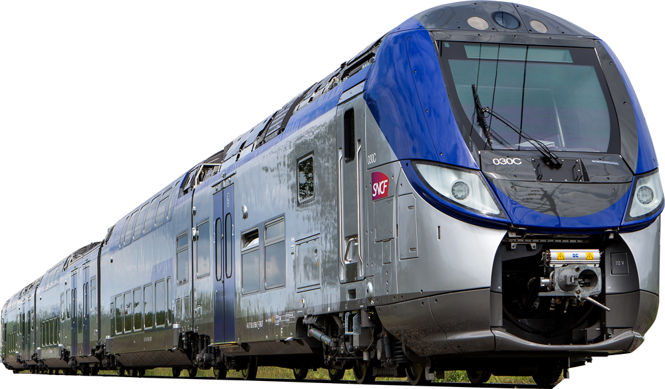



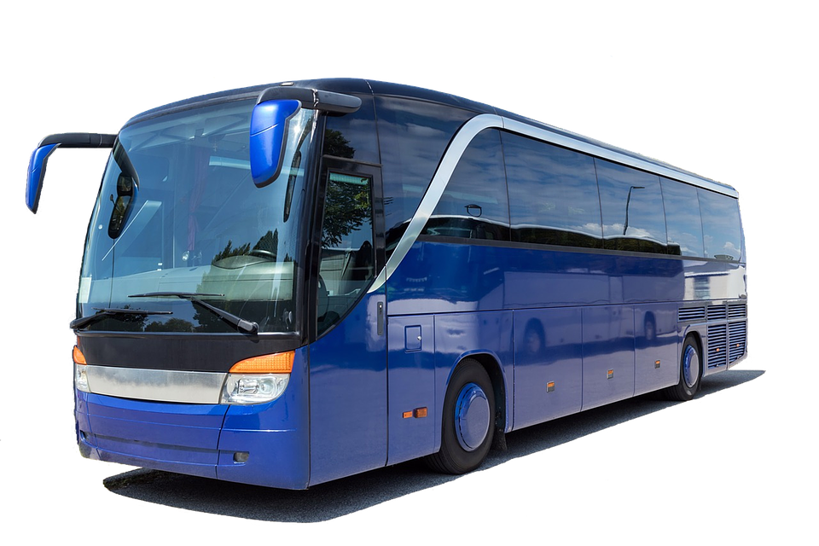
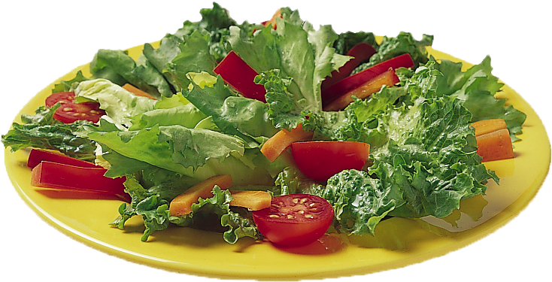
PROBLEM DECOMPOSITION
PROBLEM DECOMPOSITION
Definition:
Breaking down a problem or system into smaller, more manageable parts
Get to airport?
Cook dinner?
Notes:
Possible examples:
To make dinner, you may decide to make a salad, cook some pasta, and bake a cake for desert. Then to make the salad you can decompose that into smaller tasks….
Get from your house to the airport by public transport
Provide feedback on a student’s piece of written work

Slide 17
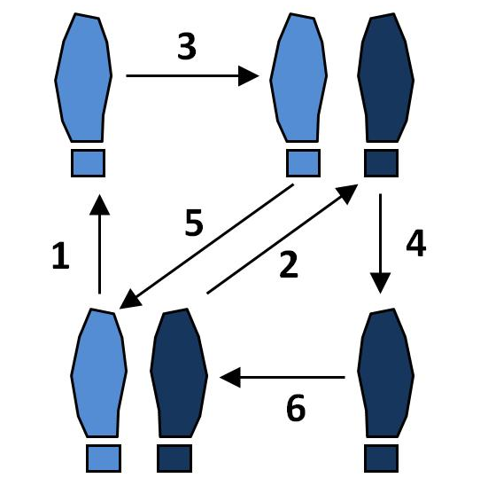
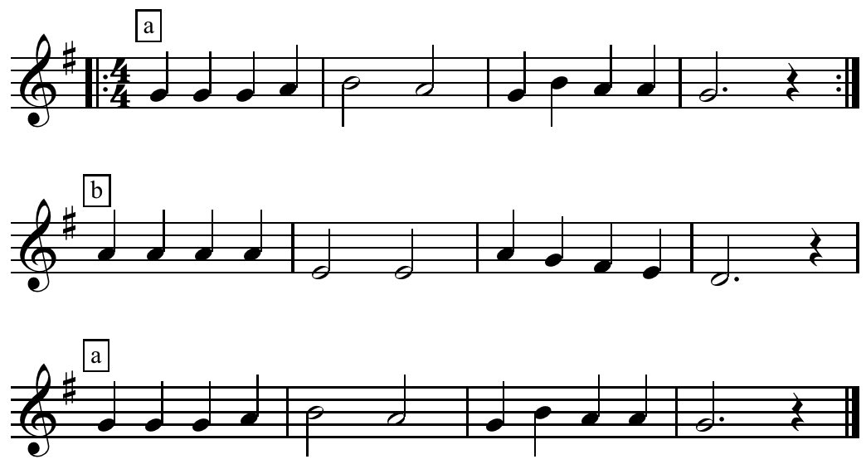
PATTERN RECOGNITION
Definition:
Finding similarities and repetition among and within situations
Dancing
Music
Notes:
For instance:
to sing a song the chorus may be repeated several times (or even specific lines within the song)
to perform a dance, certain moves will happen over and over
to write reports, you may need to get the results for each student in each KLA

Slide 18
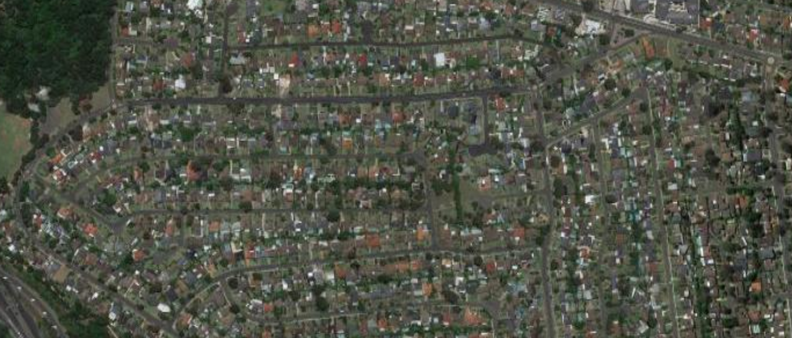



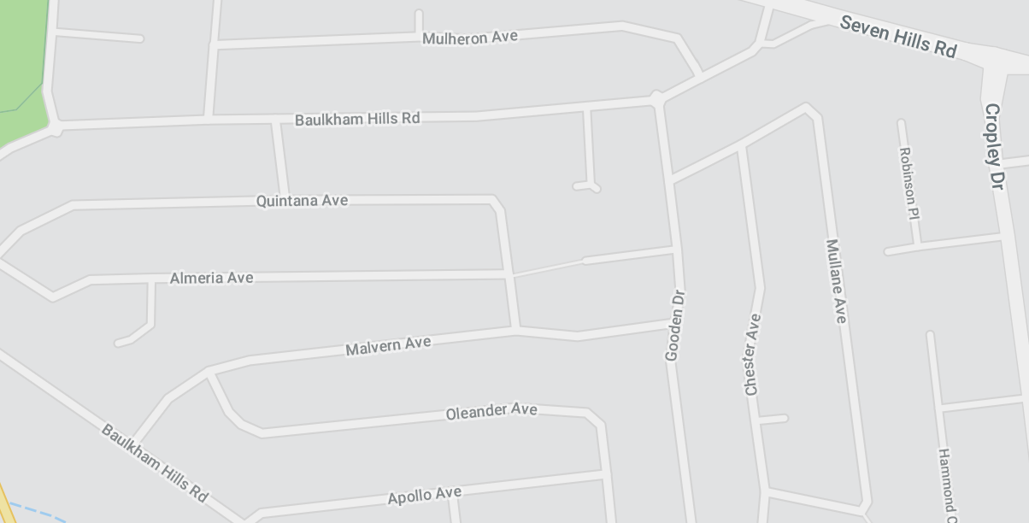
ABSTRACTION
Definition:
Focusing only on the important information and ignoring irrelevant detail
Notes:
Symbolic representation
Maps
Understanding how different algorithms may apply to different situations (supports transfer)

Slide 19

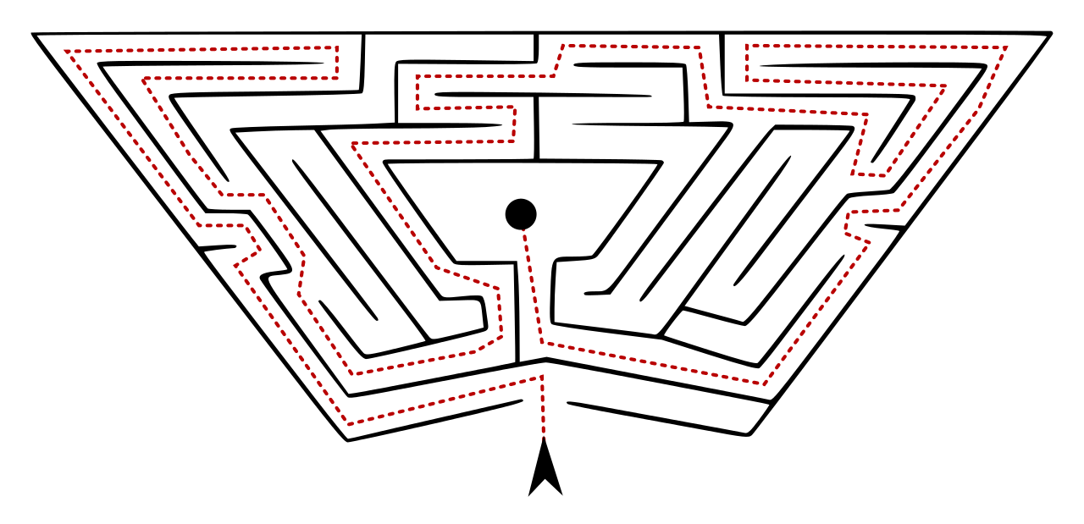
ALGORITHMIC THINKING
Definition:
Developing a step-by-step solution to the problem, or the rules to follow to solve the problem
Finding a page in a book
Solving a maze
Notes:
Examples:
How to navigate from this room to the front office
How to fold the laundry
How to find a specific page number in a book

Slide 20
Computational Thinking Elements
PROBLEM DECOMPOSITION
PATTERN RECOGNITION
ABSTRACTION
ALGORITHMIC THINKING
Breaking down a problem or system into smaller, more manageable parts
Finding similarities and repetition among and within situations
Identifying the essence of things, ideas, concepts
Designing a series of ordered steps to solve a problem

Slide 21
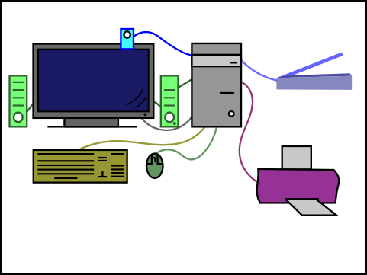
Digital Systems
In order to use technology to solve problems involving computational thinking, we need to have an understanding of digital systems
Input devices:
Keyboards, mouse, webcam, scanner
Output devices:
Screens, speakers, printer
Controllers:
computer motherboard, micro-controller
CC BY Dnikolos: https://www.flickr.com/photos/68946401@N03/6268578327

Slide 22
Workstation Activities (40 minutes)

Slide 23
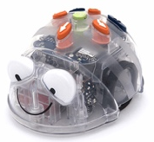
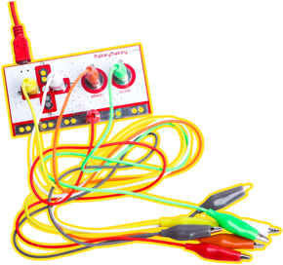
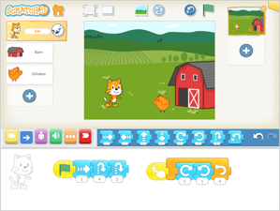
Your task….
STAGE 1
Workstation 1: Bluebot
For this task you will be helping an animal avoid predators to find food
Workstation 2: Makey Makey
For this task you will be making a set of bongo drums using different objects
Workstation 3: Scratch Jr.
For this task you will create a 1 minute animation to give your community some tips on how to save water

Slide 24
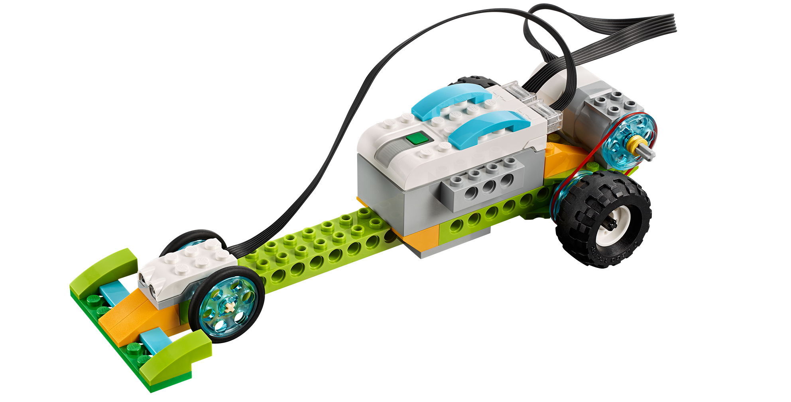
Your task….
STAGE 2
Workstation 1: Scratch
For this task you will be creating an animal guessing game based
on physical features and characteristics of animals
Workstation 2: Lego Wedo 2.0
For this task you will try to make a car go faster by changing size
of the wheels, motor power and pulley configuration
Workstation 3: Makey-Makey & Scratch
For this task you will build your own musical instrument that can be played using real world objects

Slide 25
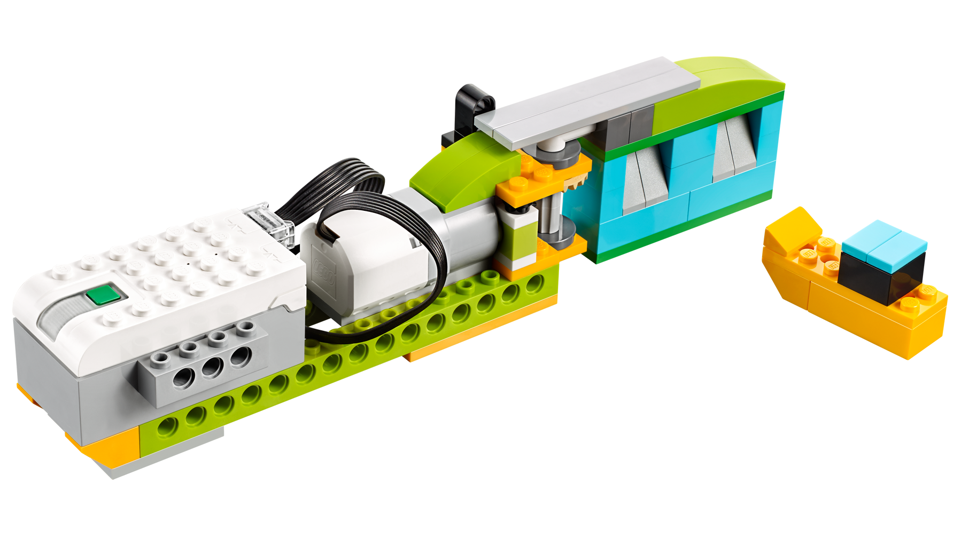
Your task….
STAGE 3
Workstation 1: Micro:bit
For this task you will write a program to play Rock-Paper-Scissors and even program the Micro:Bits to play against each other (if you have time).
Workstation 2: Lego Wedo 2.0
For this task you will build a flood gate that can help protect the surrounding areas from water damage.
Workstation 3: Scratch
For this task you will build a game that demonstrates an aspect of how to farm sustainably.

Slide 26

Your task….
Then once your group has completed the activity, please complete the teacher reflection worksheet in preparation for workshop discussion.
Those who gave us consent for audio recording:
Please pick and meet at the “microphone” workstations.

Slide 27
Brainstorming lesson ideas (5 mins)
Based on what you have learnt today, and your specific classroom context, spend 5 minutes brainstorming in groups the sort of lesson or module that you could run with your students.

Slide 28
Please go to your stage workstations and meet your tutor! :-)

Slide 29
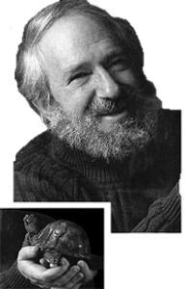
Computational Thinking Pedagogy

Slide 30
Rationales for developing CT capabilities
Seymour Papert proposes computational thinking as a unifying concept in mathematics education
(Papert, 1996)
"Computational thinking will be a fundamental skill used by everyone in the world by the middle of the 21st Century… Just like reading, writing, and arithmetic. Imagine every child knowing how to think like a computer scientist! "
(Wing, 2006)
Notes:
Papert, S. (1996). An exploration in the space of mathematics educations. International Journal of Computers for Mathematical Learning, 1(1), 95-123.
The concept was first examined by Seymour Pappert in this rather oblique paper that represents those parts of mathematical education and knowledge essential to life and progress as 'z' and proceeds to examine what such a variable might contain.
Wing, J. M. (2006). Computational thinking. Communications of the ACM, 49(3), 33-35.
image: http://www.thesmartbean.com/magazine/children-technology-magazine/computational-thinking-programming-and-the-google-app-inventor/

Slide 31

Rationales for developing CT capabilities
Technology is changing our society and Computational Thinking (CT) can:
support the development of innovative technological solutions
Advance the economic competitiveness of society
Provide a source of individual empowerment
Provide young people with a strategic approach to solving complex problems
(Education Council, 2015)
Notes:
Other relevant resource:
Günbatar, Mustafa Serkan. (2019). Computational thinking within the context of professional life: Change in CT skill from the viewpoint of teachers. Education and Information Technologies. 10.1007/s10639-019-09919-x.

Slide 32
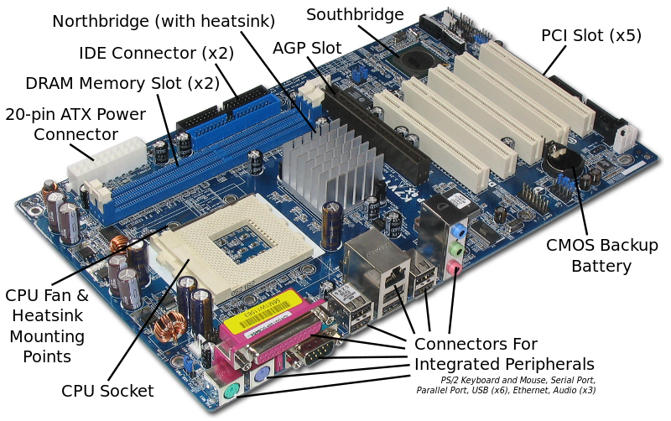

Computational thinking pedagogy
NOTIONAL MACHINE (DU BOULAY ET AL.)
Notional machine: “an idealised, conceptual computer whose properties are implied by the constructs in the programming language employed” (du Boulay, et al., 1989, p. 431)
A primary part of the teacher’s role is to help develop students’ mental models of how the computer system works
Strategies for incremental development of the notional machine mental model:
  Making actions visible
  Providing a working commentary
  Simplifying the instruction set (number of instructions)
  Simplifying syntax (way instructions are represented)
  Simplifying the logical complexity of the task
https://www.flickr.com/photos/55524309@N05/5378321210
https://en.wikibooks.org/wiki/How_To_Assemble_A_Desktop_PC/Assembly

Slide 33
Computational thinking pedagogies
RESEARCH IN HIGHER EDUCATION…
Strategies that have been shown to support learning of computing in Higher Education:
Pair programming
Using metaphors
Mindmapping
Cooperative learning
Multi-sensory learning and teaching methods
Visualisation strategies (e.g. drawing diagrams)
Scaffolding (for instance providing a partially completed program)
Reflection (both of peers and self)
(Lye, 2014)
However there is very little in-depth research investigating what supports learning of computational thinking in schools!

Slide 34

Computational thinking pedagogies
SPACE TO LEARN - “LARGE ROOM” APPROACH
Recommends authentic tasks that provide:
“Low floor” – easy entry for any ability level
“High ceiling” – opportunity to extend capable and interested students
“Wide walls” – accommodating a variety of project ideas and methods
(Resnick, 2009)
https://en.wikipedia.org/wiki/Library#/media/File:Melk_-_Abbey_-_Library.jpg

Slide 35
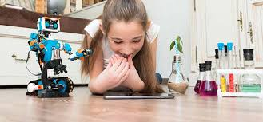
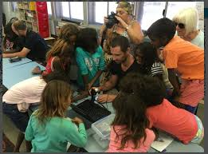
Encouraging all students
Supporting girls: General:
Girls who STEM AMT. (Australian Maths Trust) comps + programs
https://bit.ly/2LmetY5 https://bit.ly/2ZhhGdU
Techgirls are superheroes
https://bit.ly/RWJJMH
Women in computer science
https://bit.ly/2HsGNlp
Supporting Indigenous students:
STEM and indigenous students (report)
https://bit.ly/2GD5GMr
Getting Indigenous kids into STEM
https://bit.ly/2ZkfRwJ
Supporting low SES students:
Supporting low SES schools with STEM
https://bit.ly/2yAXMPz
Effective teaching and support of students from low socioeconomic status backgrounds
https://bit.ly/2GAL3jW

Slide 36
Where to find out more…
We have provided extensive links and resources for you on the workshop website:
http://bit.ly/mqmoodle
Your username and password is the prefix of your email address (before the ‘@’ symbol), for example:
username: matt.bower4
password: matt.bower4

Slide 37
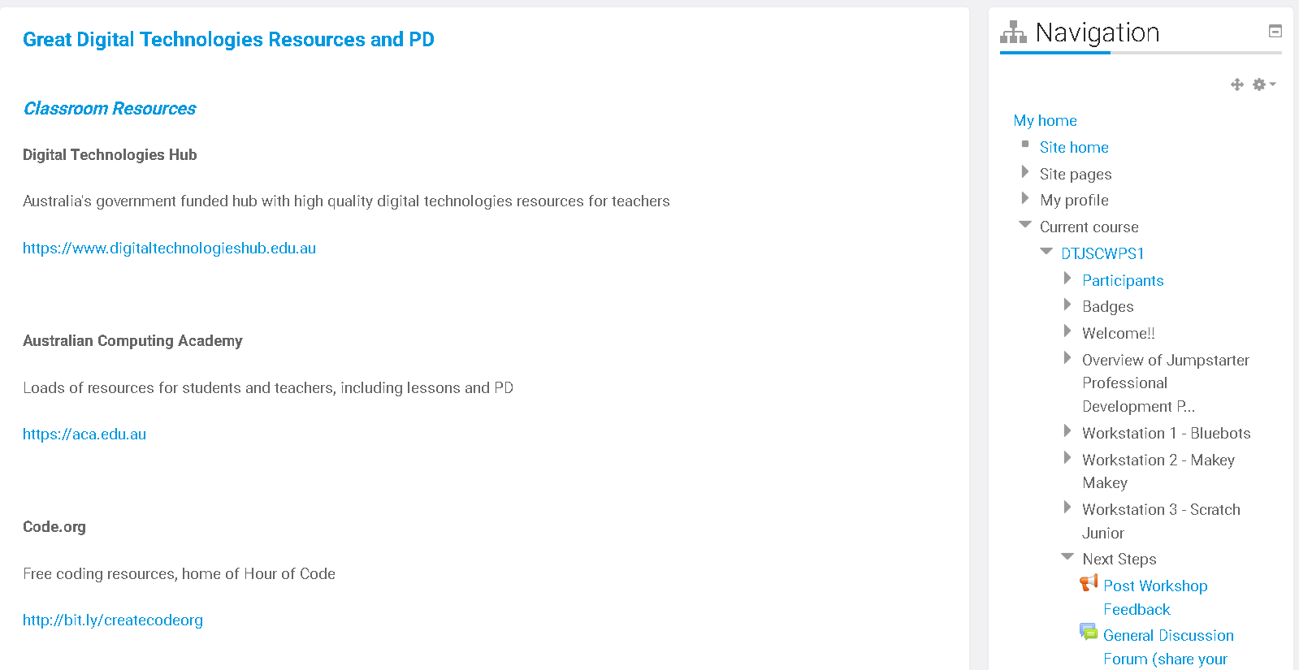
Where to find out more…
Moodle: http://bit.ly/mqmoodle
Notes:
Resources:
PD
CSER MOOCs (free online professional learning courses mapped to the Australian Digital Technologies Curriculum for teachers from grades K-10)
bit.ly/CSERMOOC
PL in a Box
(DIY materials to run your own professional learning workshops in digital technologies and cross curricula areas)
bit.ly/CSERPDBox
Google Educator PD Grant Workshops
(teacher professional development workshops supported by Google for AU/NZ)
bit.ly/GoogleEducatorGrants
National Digital Readiness Programme
(New Zealand Professional Development preparing teachers to teach Digital Technologies)
bit.ly/kiatakatu
STEM Professionals in Schools
(CSIRO run program connecting industry with teachers in the STEM space)
bit.ly/CSIROSTEMProfessionals
CSER University of Adelaide
(There are many available resources to support you in learning more about Digital Technologies)
https://csermoocs.adelaide.edu.au/resources
Classroom Resources
CS First
(free theme based materials to teach coding)
bit.ly/GoogleCSFIRST
Computational thinking resources from Google & Partners
bit.ly/GoogleCompThinking
AI with Google
(resources for incorporating AI/ML into your classroom)
bit.ly/GoogleAIResources
Google Applied Digital Skills
(teach and learn practical digital skills for success in the classroom and your future job)
bit.ly/AppliedDigSkills
Google Computer Science Education resources
(global programs supporting teachers and students)
bit.ly/GoogleCSResources
CS Unplugged
(free & open source materials to teach computer science without a computer
bit.ly/CSUnpluggedResources
CS Field Guide
(free online guide for students learning computer science)
bit.ly/CSFieldGuide
MadMaker
(6 week online STEM course for yr 9-10 students using tech to solve real world problems)
bit.ly/madmakerresources
Code.org
(free coding resources, home of Hour of Code)
bit.ly/createcodeorg
MIT App Inventor
(intuitive, visual programming environment allowing everyone to build fully functional apps for smartphones and tablets
bit.ly/MITAppInvent

Slide 38

Next steps…
Your task:
Design, refine & implement a lesson of work relating to digital technologies / computational thinking (it can use any technology, context or learning outcomes!)
Share your lesson / module and associated reflections with your peers on the Moodle forum. Please provide:
  a description of your lesson/model including any resources, lesson plans, photos etc) that you are willing to share
  an explanation what worked well in your lesson/module
  difficulties that students experienced
  pedagogical strategies and advice for colleagues who might try to implement your lesson/module
Completing this task along with a brief post implementation survey we will send you entitles you to 7 hours of NESA registered PD at proficient level.

Slide 39

The future is in our hands!
matt.bower@mq.edu.au
@mattgbower

Slide 40
References
Du Boulay, B. (1986). Some difficulties of learning to program. Journal of Educational Computing Research, 2(1), 57-73.
Education Council (2015). National STEM school education strategy: A comprehensive plan for science, technology, engineering and mathematics education in Australia. Education Council (of Australian education ministers).
Lye, S. Y., & Koh, J. H. L. (2014). Review on teaching and learning of computational thinking through programming: What is next for K-12?. Computers in Human Behavior, 41, 51-61.
Papert, S. (1996). An exploration in the space of mathematics educations. International Journal of Computers for Mathematical Learning, 1(1), 95-123.
Resnick, M., Maloney, J., Monroy-Hernández, A., Rusk, N., Eastmond, E., Brennan, K., et al. (2009). Scratch: programming for all. Communications of the ACM, 52(11), 60-67.
Wing, J. M. (2006). Computational thinking. Communications of the ACM, 49(3), 33-35.

